Slide 1

Objectives
In this session, you will learn to:
  Design a view component
  Describe the Hypertext Transfer Protocol
  Describe the web container behavior
  Develop a simple HTTP servlet
  Identify the features of a Web Container
  Deploy a Web Application
  Configure and deploy a servlet
Notes:
Start the session by explaining the objectives listed in Slide 1. Students should understand the structure of HTTP requests and responses. Next, students should be able to create a view servlet that generates a dynamic response.
Three activities are interspersed throughout the lecture.
Use the following flow:
● Design a view component
Exercise 1: Design the Show List of DVDs use case
● Describe the Hypertext Transfer Protocol
● Describe the web container behavior
● Develop a view servlet
Exercise 2: Implement and compile the ListLibraryServlet
● Configure and deploy a servlet
Exercise 3: Configure the servlet, deploy, and test

Slide 2
Types of View Components
There are four fundamentals types of views:
  Data presentation
  Data forms
  Navigational aids
  Informational screens or pop-ups
Notes:
Use this slide to explain to the students about the four fundamental types of View components.

Slide 3
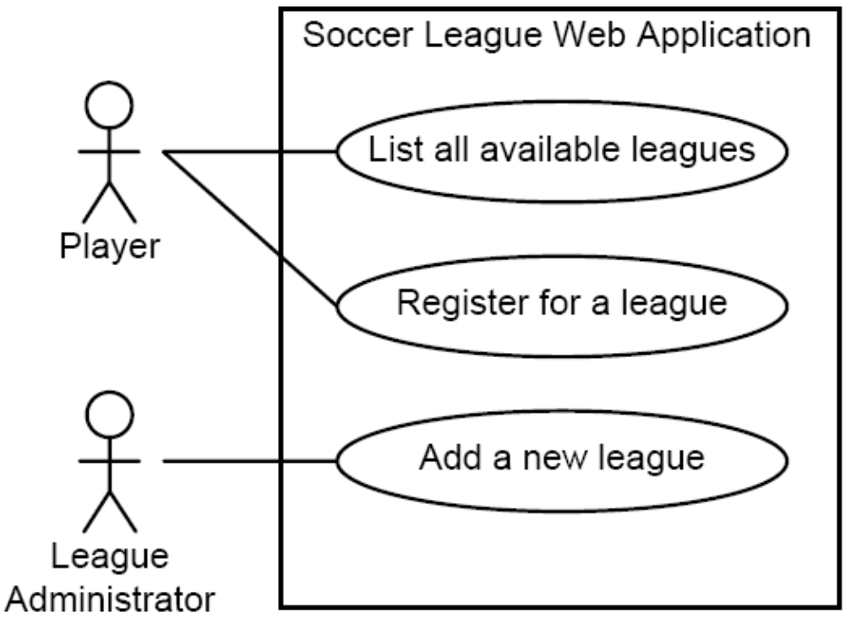
Soccer League Case Study
Notes:
Use this slide to explain to the students about the Soccer League domain through the use case diagram. The Soccer League case study will be used throughout this course for Web application development.

Slide 4
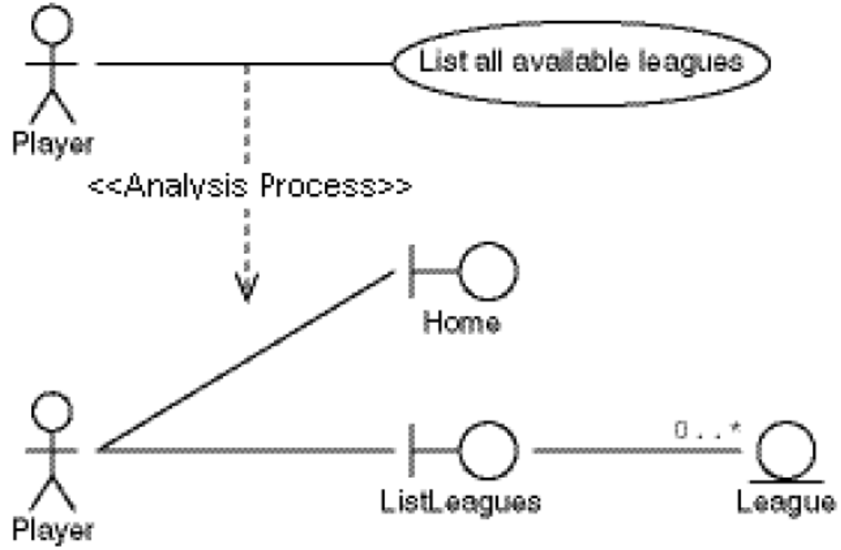
List Leagues Analysis Model
Notes:
Use this slide to explain to the students about the Analysis model for the List All Available Leagues use case. Also, explain the three components of the Analysis model.

Slide 5
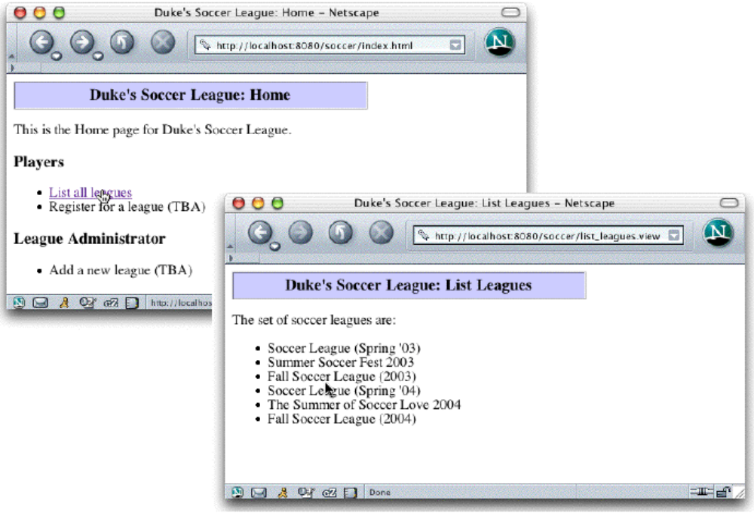
List Leagues Page Flow
Notes:
Use this slide to explain to the students about the List Leagues Page flow.

Slide 6
Home Page HTML
1 <html>
2
3 <head>
4 <title>Duke’s Soccer League: Home</title>
5 </head>
6
7 <body bgcolor=’white’>
8
9 <!-- Page Heading -->
10 <table border=’1’ cellpadding=’5’ cellspacing=’0’ width=’400’>
11 <tr bgcolor=’#CCCCFF’ align=’center’ valign=’center’ height=’20’>
12 <td><h3>Duke’s Soccer League: Home</h3></td>
13 </tr>
14 </table>
15
Notes:
Use slides 6 and 7 to describe the coding of the Home page for the Soccer League Web application.

Slide 7
Home Page HTML (Contd.)
16 <p>
17 This is the Home page for Duke’s Soccer League.
18 </p>
19
20 <h3>Players</h3>
21
22 <ul>
23 <li><a href=’list_leagues.view’>List all leagues</a></li>
24 <li>Register for a league (TBA)</li>
25 </ul>
26
27 <h3>League Administrator</h3>
28
29 <ul>
30 <li>Add a new league (TBA)</li>
31 </ul>
32
33 </body>
34
35 </html>

Slide 8
List Leagues Page HTML
9 <!-- Page Heading -->
10 <table border=’1’ cellpadding=’5’ cellspacing=’0’ width=’400’>
11 <tr bgcolor=’#CCCCFF’ align=’center’ valign=’center’ height=’20’>
12 <td><h3>Duke’s Soccer League: List Leagues</h3></td>
13 </tr>
14 </table>
15
16 <p>
17 The set of soccer leagues are:
18 </p>
19
20 <ul>
21 <li>The Summer of Soccer Love 2004</li>
22 <li>Fall Soccer League (2003)</li>
23 <li>Fall Soccer League (2004)</li>
24 <li>Soccer League (Spring ‘03)</li>
25 <li>Summer Soccer Fest 2003</li>
26 <li>Soccer League (Spring ‘04)</li>
27 </ul>
28
29 </body>
30 </html>
Notes:
Use this slide to explain the HTML output code for the List Leagues page.

Slide 9
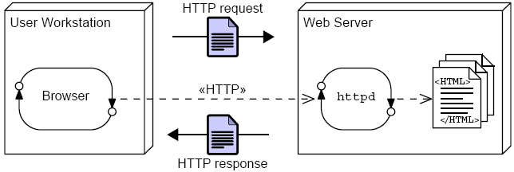
Hypertext Transfer Protocol
The HTTP client sends a single request to the HTTP daemon (httpd) and responds with the requested resource.
Notes:
Use this slide to explain to the students about the Hypertext Transfer protocol and its methods. Use the table given in SG to describe the HTTP methods.

Slide 10
HTTP GET Method
A web browser issues an HTTP GET request when:
  The user selects a link in the current HTML page
  The user enters a Universal Resource Locator (URL) in the Location field (Netscape Navigator™) or the Address field (Microsoft Internet Explorer)
Notes:
Use this slide to explain to the students about the HTTP GET method.

Slide 11
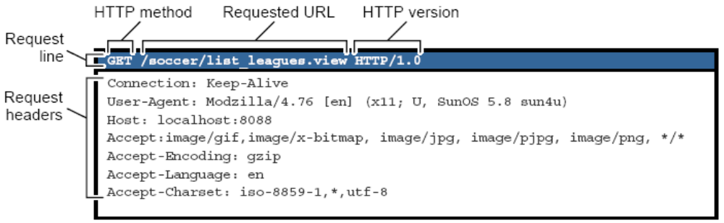
HTTP Request
Notes:
Use this slide to explain to the students about the HTTP Request.

Slide 12
HTTP Request Headers
Headers are provided in the request by the client and can modify how the request is processed on the server.
Example headers:
Header | Use
Accept | The MIME types the client can receive
Host | The internet host and port number of the resource being requested
Referer | The address from which the Request-Universal Resource Identifier (URI) was obtained
User-Agent | The information about the client originating the request
Notes:
Use this slide to explain to the students about the HTTP Request Headers.

Slide 13
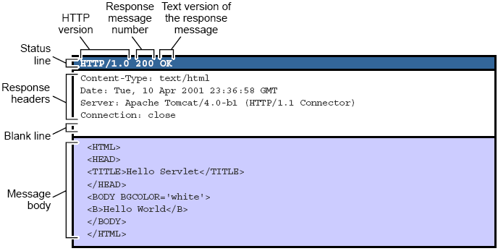
HTTP Response
Notes:
Use this slide to explain to the students about the HTTP Response.

Slide 14
HTTP Response Headers
Headers are provided in the response by the server and can modify how the response is processed on the client.
Example headers:
Header | Use
Content-Type | A MIME type (such as text/html) which classifies the type of data in the response
Content-Length | The length (in bytes) of the payload of the response
Server | An informational string about the server that responded to this HTTP request
Cache-Control | A directive for the web browser (or proxies) to indicate whether or not the content of the response should be cached
Notes:
Use this slide to explain to the students about the HTTP Response Headers.

Slide 15
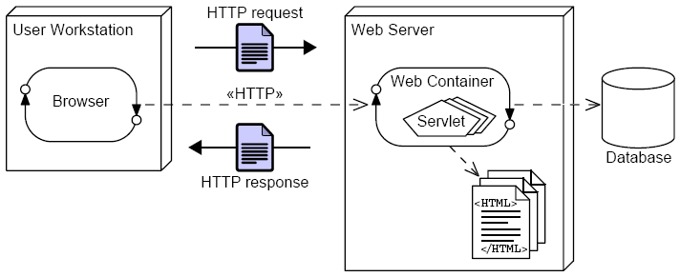
Web Container Architecture
A web container can be used to process HTTP requests by executing the service method on an HttpServlet object.
Notes:
Use this slide to explain to the students about the Web Container architecture.

Slide 16
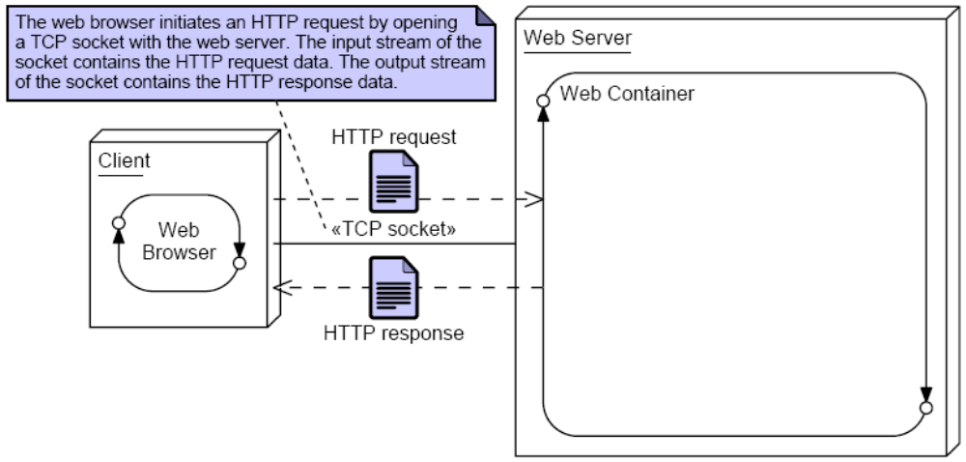
Request and Response Process
Notes:
Use slides 16,17, 18 and 19 to explain to the students about the request and response process.

Slide 17
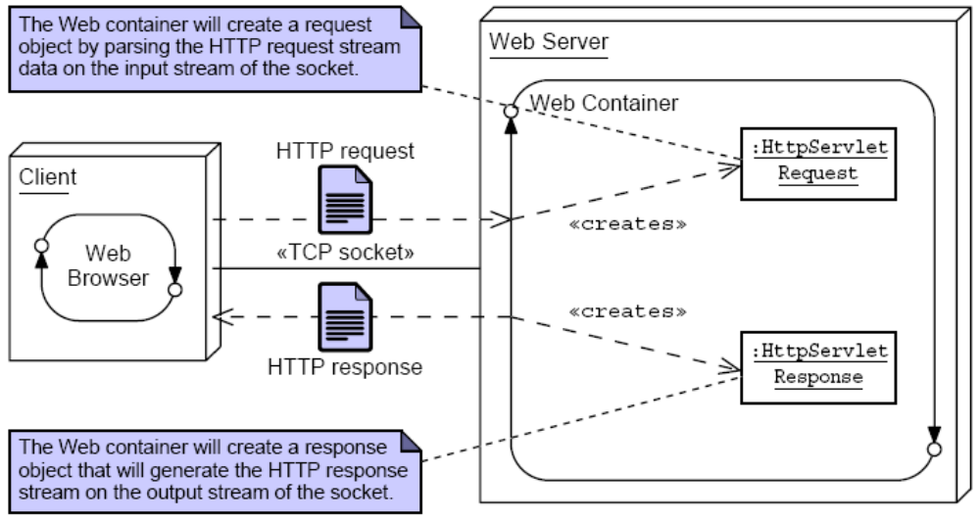
Request and Response Process (Contd.)

Slide 18
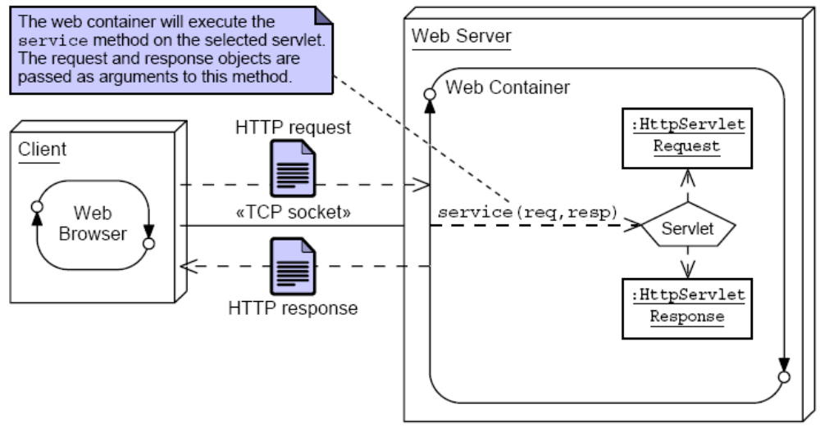
Request and Response Process (Contd.)

Slide 19
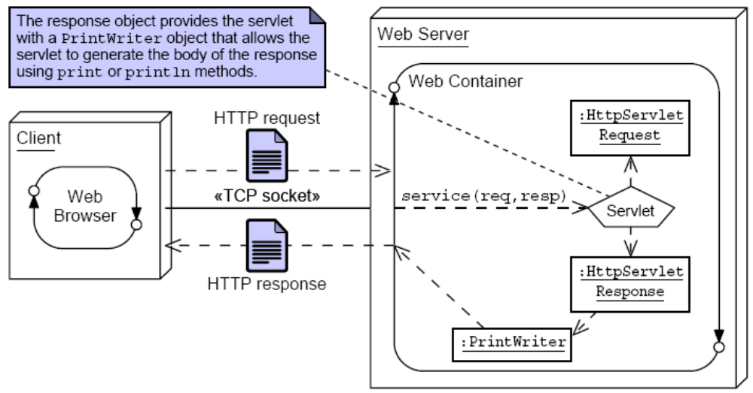
Request and Response Process (Contd.)

Slide 20
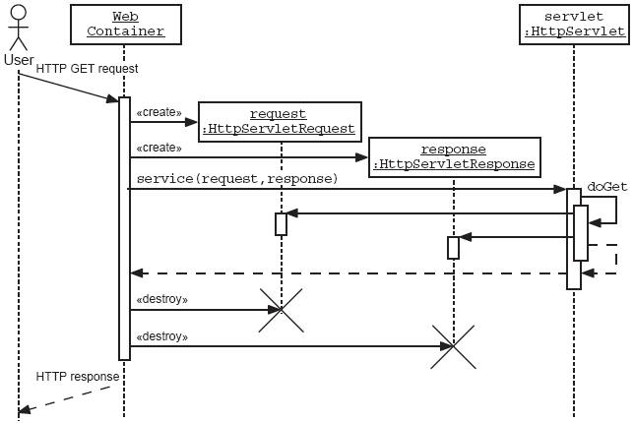
Sequence Diagram of an HTTP GET Request
Notes:
Use this slide to explain to the students with the help of an sequence diagram, how an HTTP GET Request is processed.

Slide 21
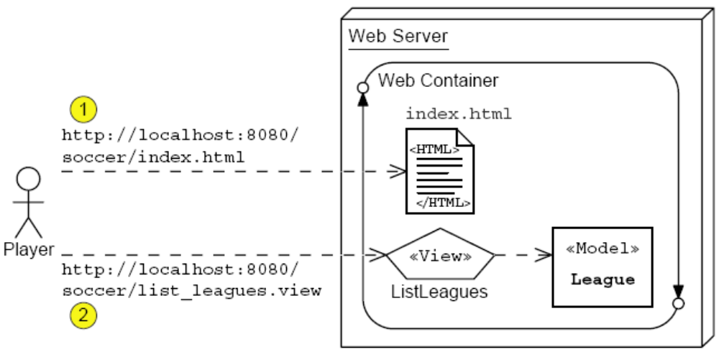
List Leagues Architecture Model
Notes:
Use this slide to explain to the students about the List Leagues architecture model. Also discuss about the HttpServlet API. The default doXyx methods in the HttpServlet class have default implementations, which send an HTTP status code of 503 (Service Unavailable). Therefore, it is important that, if the servlet must process both GET and POST requests, both doGet and doPost methods are overridden.
Explain about the HttpServletRequest API and HttpServletResponse API. While using HttpServletResponse API, you need to set the content type of the response text. If an HTTP servlet does not set the content type to text/html, then the response is sent with the text/plain MIME type, which most web browsers interpret by showing all of the HTML tags in the screen.

Slide 22
Demo: The Soccer League Web Application
Demo: The Soccer League Web Application
Notes:
Use this slide to demonstrate the Soccer League Web Application. You can run the project, ViewDemo stored at Datafiles For Faculty\Session02\Demo1\mod02_view.zip file in the TIRM CD.
To create a fresh Soccer League Web Application, you need to perform the following tasks:
1. Create a project, ViewDemo in the NetBeans IDE 5.5.1.
2. Create an index.html file.
3. Create the League.java file in the sl314.model package.
4. Create the ListLeaguesServlet.java file in the sl314.view package.
5. Configure the web.xml file.
6. Build and run the project.

Slide 23
Introducing a Web Container
A Web container is a runtime environment that manages the components, such as Servlets, JSP Pages, filters, Web event listeners, of a Web application. The following features are provided by the web container to all Web applications:
  Communication Support
  Lifecycle Management
  Multithreading Support
  Declarative Security
  JSP Support
Notes:
Use this slide to explain about the features provided by a Web container

Slide 24
Deploying a Web Application
A web application in Web server is structured as a hierarchy of directories and files in a standard layout.
You can access this hierarchy in an unpackaged form or a packaged form.
Each Web application in a Web Server is given a unique context root, which is the name of the Web application as seen by the browser.
The top-level directory of the Web application hierarchy is also known as the context root of the application.
The context root directory is immediately followed by the WEB-INF directory.
The directories such as classes, lib, and tags are placed immediately inside the WEB-INF directory.
Notes:
Use this slide to explain about deploying Web applications.

Slide 25
Deploying a Web Application (Contd.)
The directory and files contained in the context root of the Web application are:
  Html files, JSP files, image files, and style sheets: The HTML files and JSP pages, which can be accessed by the client directly, are placed under the context root of the Web application
  /WEB-INF/web.xml: The web.xml file is the deployment descriptor for the Web application. This is an XML file that describes the servlet mappings, welcome files and other components that make up the Web application
  /WEB-INF/classes/: The classes directory contains any Java class files required for your application. If the Java classes are organized into Java packages, the package must reflect under the /WEB-INF/classes/ directory
Notes:
Use this slide to explain about the directory and files contained in the context root of the the Web application.

Slide 26
Deploying a Web Application (Contd.)
  /WEB-INF/lib/: The lib directory contains the JAR files that contain Java class files, TLD files, and other associated resources required for the Web application
Notes:
Use this slide to explain about the directory and files contained in the context root of the the Web application.

Slide 27
Deploying WAR Files
A WAR file is a JAR file containing the Web application structure in a portable and compressed form.
To facilitate the creation of a WAR file in the required format, you need to arrange the directory and files of your Web application in the appropriate format.
When you build a new project, a dist folder is created in the project folder that you have created in NetBeans IDE 5.5.1.
The .war file is created in the dist folder that you can use for deploying on the application server.
Notes:
Use this slide to explain about the WAR file. A WAR (Web Archive) file is a JAR file used to distribute a Web application in compressed form. The Web application contains a collection of JavaServer Pages, servlets, Java classes, XML files, tag libraries and static Web pages (HTML and related files).

Slide 28
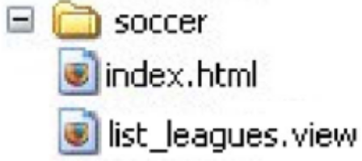
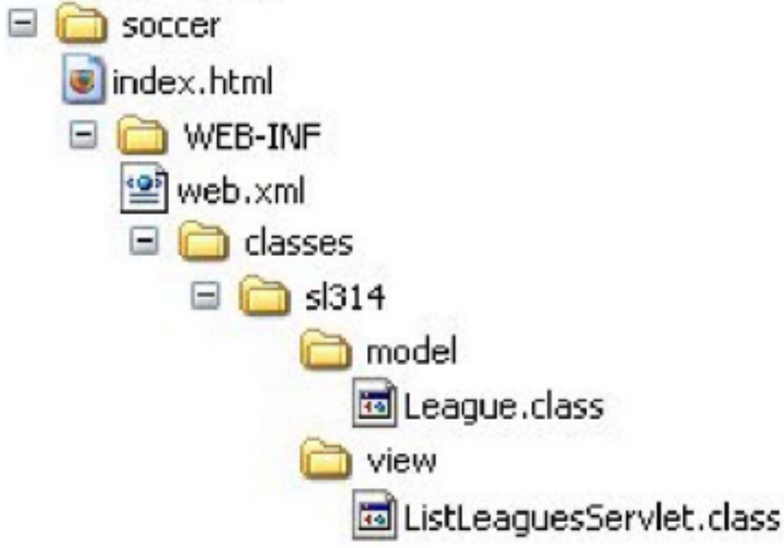
Soccer League Web Application Structure
The logical web application hierarchy:
The physical web application hierarchy:
Notes:
Use this slide to explain about the Soccer League Web application structure.

Slide 29
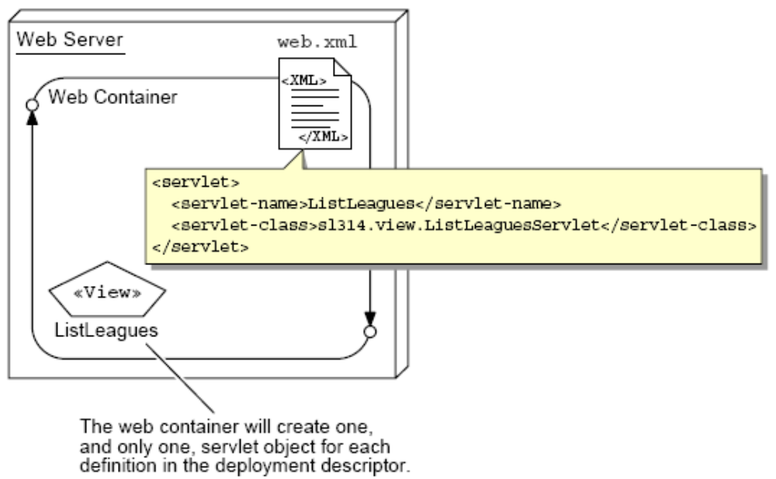
Configuring a Servlet Definition
Notes:
Use this slide to explain about configuring a servlet definition. The web.xml file is used to configure the servlet components.

Slide 30
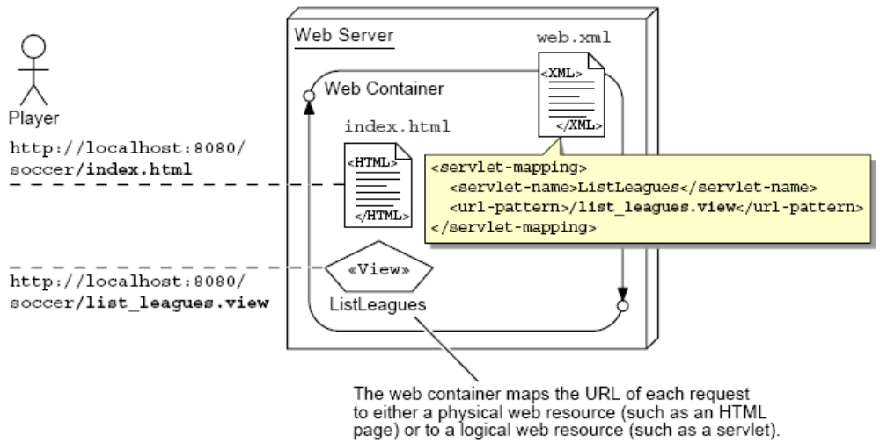
Configuring a Servlet Mapping
Notes:
Use this slide to explain about configuring a Servlet mapping in the web.xml file.

Slide 31
Complete Deployment Descriptor
1 <?xml version=”1.0” encoding=”ISO-8859-1”?>
2
3 <web-app
4 xmlns=”http://java.sun.com/xml/ns/j2ee”
5 xmlns:xsi=”http://www.w3.org/2001/XMLSchema-instance”
6 xsi:schemaLocation=”http://java.sun.com/xml/ns/j2ee
7 http://java.sun.com/xml/ns/j2ee/web-app_2_4.xsd”
8 version=”2.4”>
9
10 <display-name>SL-314 WebApp Example</display-name>
11 <description>
12 This Web Application demonstrates a single View servlet.
13 </description>
14
15 <servlet>
16 <servlet-name>ListLeagues</servlet-name>
17 <servlet-class>sl314.view.ListLeaguesServlet</servlet-class>
18 </servlet>
19
Notes:
Use this slide to explain the coding of the web.xml file for the Soccer League Web application that you demonstrated in Slide 22.

Slide 32
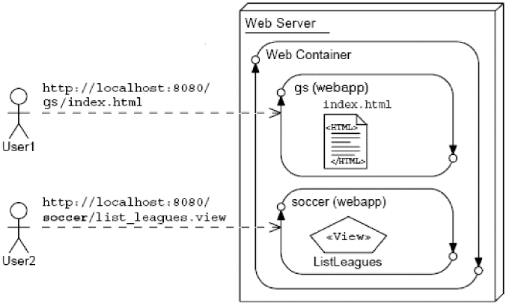
Web Application Context Root
Notes:
Use this slide to explain about the context root of the Web application. The Web container supports multiple, isolated web applications running in a server instance. Therefore, each Web application running in a server is given a unique base URL, which is called a context root (or context path). The application server uses this initial portion of the URL, which immediately follows the http://hostname, to determine which web application services the client request.

Slide 33
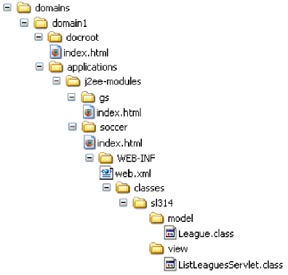
Sun Java™ System Application Server Deployment
Notes:
Use this slide to explain to the students about the Sun Java System Application Server deployment.

Slide 34
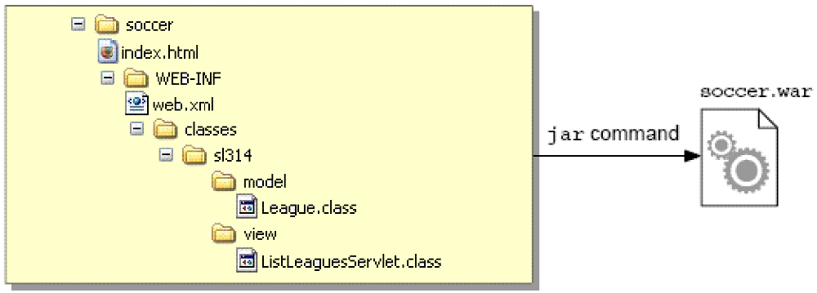
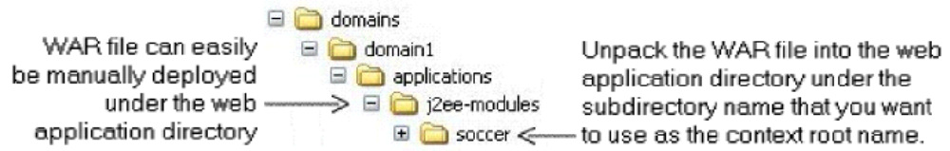
WAR Files for Deployment
Application Server deployment of a WAR file:
Notes:
Use this slide to explain about the WAR files for deployment of the Web application.

Slide 35

Activating the Servlet in a Web Browser
Request for http://localhost:8080/soccer/index.html presents:
HTML:
  20 <h3>Players</h3>
  21
  22 <ul>
  23 <li><a href=’list_leagues.view’>List all
  leagues</a></li>
  24 <li>Register for a league (TBA)</li>
  25 </ul>
Clicking on List performs a GET request for the URL: http://localhost:8080/soccer/list_leagues.view
Notes:
Use this slide to explain how to activate the servlet in a Web browser.

Slide 36
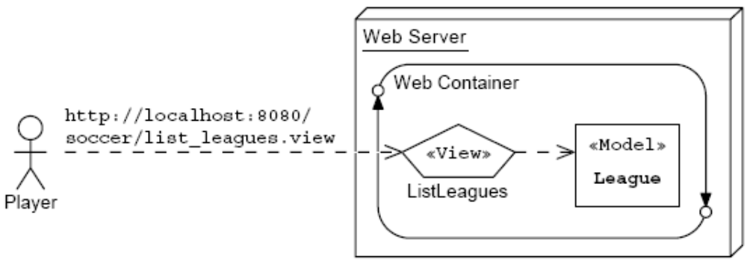
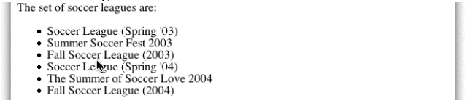
Activating the ListLeagues View
Request for the list_league.view is sent to the container:
This servlet generates this view:
Notes:
Use this slide to explain how to activate the ListLeagues View for the Soccer League Web application.

Slide 37
Summary
In this session, you learned:
  You can use a view component to display data, present a form, present informational messages, and so on.
  The HTTP protocol provides a mechanism to request static or dynamic views.
  The web container intercepts the HTTP request and activates the necessary servlet.
  You can develop a servlet class that implements the doGet method to process a request.
  You can access data from the request stream using the request object provided by the web container.
  You can generate a view by writing to the output stream of the request object provided by the container.
Notes:
End the session by discussing the summary points as given in this Slide.

Slide 38
Summary (Contd.)
  The Web container provides the following features to a Web application:
    Communication support
    Lifecycle management
    Multithreading support
    Declarative security
    JSP support
  Each Web application is given a unique context root, which is the name of the Web application as seen by the browser.
  The top-level directory of the Web application hierarchy is also known as the context root of the application.
  The directories such as classes, lib, and tags are placed immediately inside the WEB-INF directory.
Notes:
Use Slides 37 and 38 to end the session by discussing the summary points as given in Slide 25.

Slide 39
Summary (Contd.)
  The web.xml file is the deployment descriptor for the Web application.
  The deployment descriptor file describes the servlet mappings, welcome files and other components that make up the Web application.
Notes:
End the session by discussing the summary points as given in Slide 25.

